Slide 1

Graph Data Structure

Slide 2


Slide 3
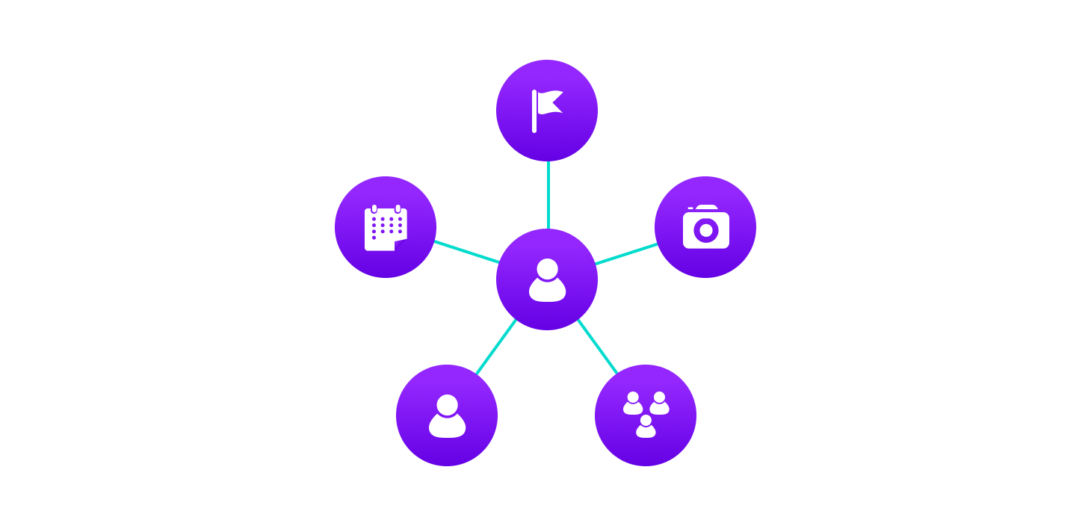

Graph Data Structures
Collection of nodes that have data and are connected to other nodes by edges.
Ex: On facebook, everything is a node. That includes User, Photo, Album, Event, Group, Page, Comment, Story, Video, Link, Note...anything that has data is a node(data containing entity).
Every relationship is an edge from one node to another. Whether you post a photo, join a group, like a page, etc., a new edge is created for that relationship.

Slide 4
All of facebook is then a collection of these nodes and edges. This is because facebook uses a graph data structure to store its data.

Slide 5

More precisely, a graph is a data structure (V, E) that consists of
A collection of vertices V
A collection of edges E, represented as ordered pairs of vertices (u,v)
Notes:
V = {0, 1, 2, 3} E = {(0,1), (0,2), (0,3), (1,2)} G = {V, E}

Slide 6

Graph Terminology
Adjacency: A vertex is said to be adjacent to another vertex if there is an edge connecting them.
Path: A sequence of edges that allows you to go from vertex A to vertex B is called a path.
Directed Graph: A graph in which an edge (u,v) doesn't necessarily mean that there is an edge (v, u) as well. The edges in such a graph are represented by arrows to show the direction of the edge.

Slide 7
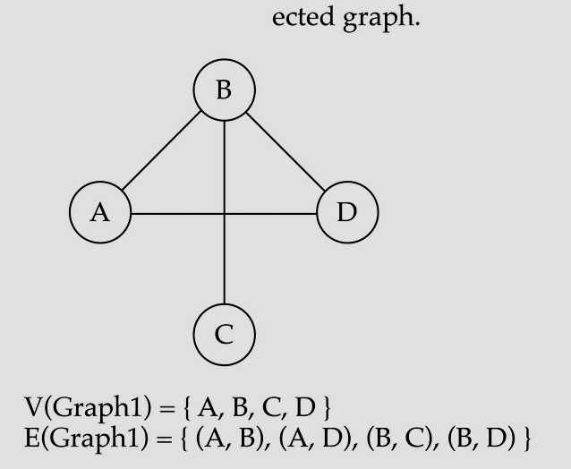
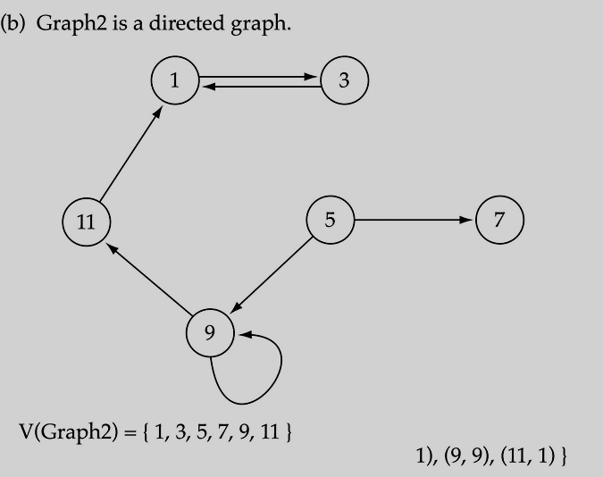
Directed VS Undirected Graph

Slide 8
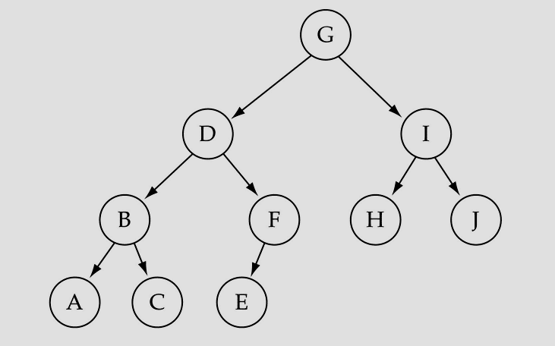
Trees VS Graphs
Trees are special cases of graphs!!
Direction

Slide 9

Graph Representation

Slide 10
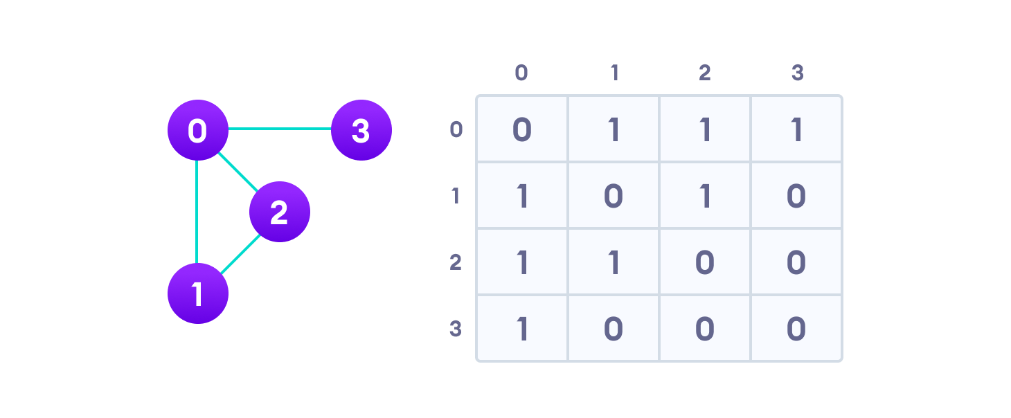
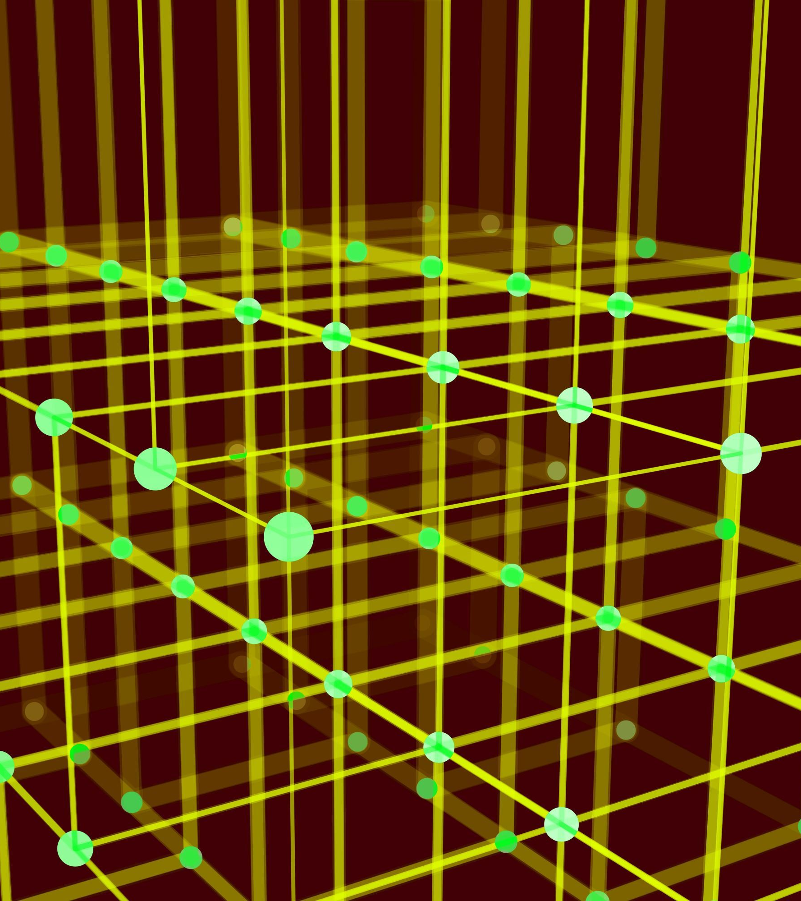
1. Adjacency Matrix
An adjacency matrix is a 2D array of V x V vertices. Each row and column represent a vertex.
If the value of any element a[i][j] is 1, it represents that there is an edge connecting vertex i and vertex j.

Slide 11
Since it is an undirected graph, for edge (0,2), we also need to mark edge (2,0); making the adjacency matrix symmetric about the diagonal.
Edge lookup(checking if an edge exists between vertex A and vertex B) is extremely fast in adjacency matrix representation but we have to reserve space for every possible link between all vertices(V x V), so it requires more space.

Slide 12
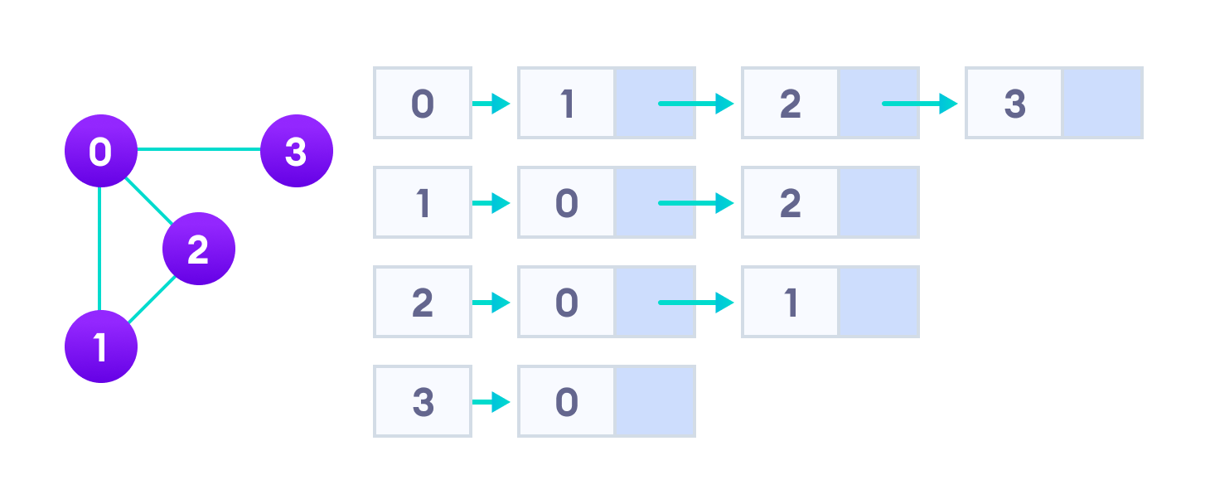

2. Adjacency List
An adjacency list represents a graph as an array of linked lists.
The index of the array represents a vertex and each element in its linked list represents the other vertices that form an edge with the vertex.
Notes:
An adjacency list is efficient in terms of storage because we only need to store the values for the edges. For a graph with millions of vertices, this can mean a lot of saved space.

Slide 13

Graph Operations

Slide 14

Graph Operations
The most common graph operations are:
Check if the element is present in the graph
Graph Traversal
Add elements(vertex, edges) to graph
Finding the path from one vertex to another

Slide 15
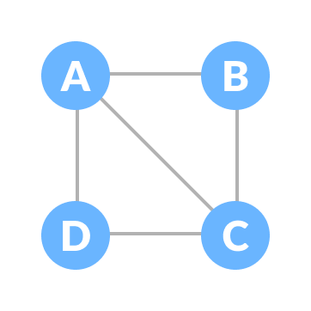
Spanning Tree and Minimum Spanning Tree
Before we learn about spanning trees, we need to understand two graphs: undirected graphs and connected graphs.
An undirected graph is a graph in which the edges do not point in any direction (ie. the edges are bidirectional).

Slide 16

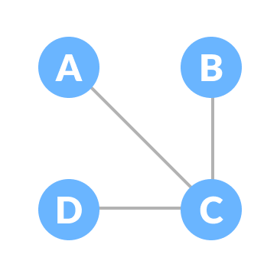
A connected graph is a graph in which there is always a path from a vertex to any other vertex.

Slide 17
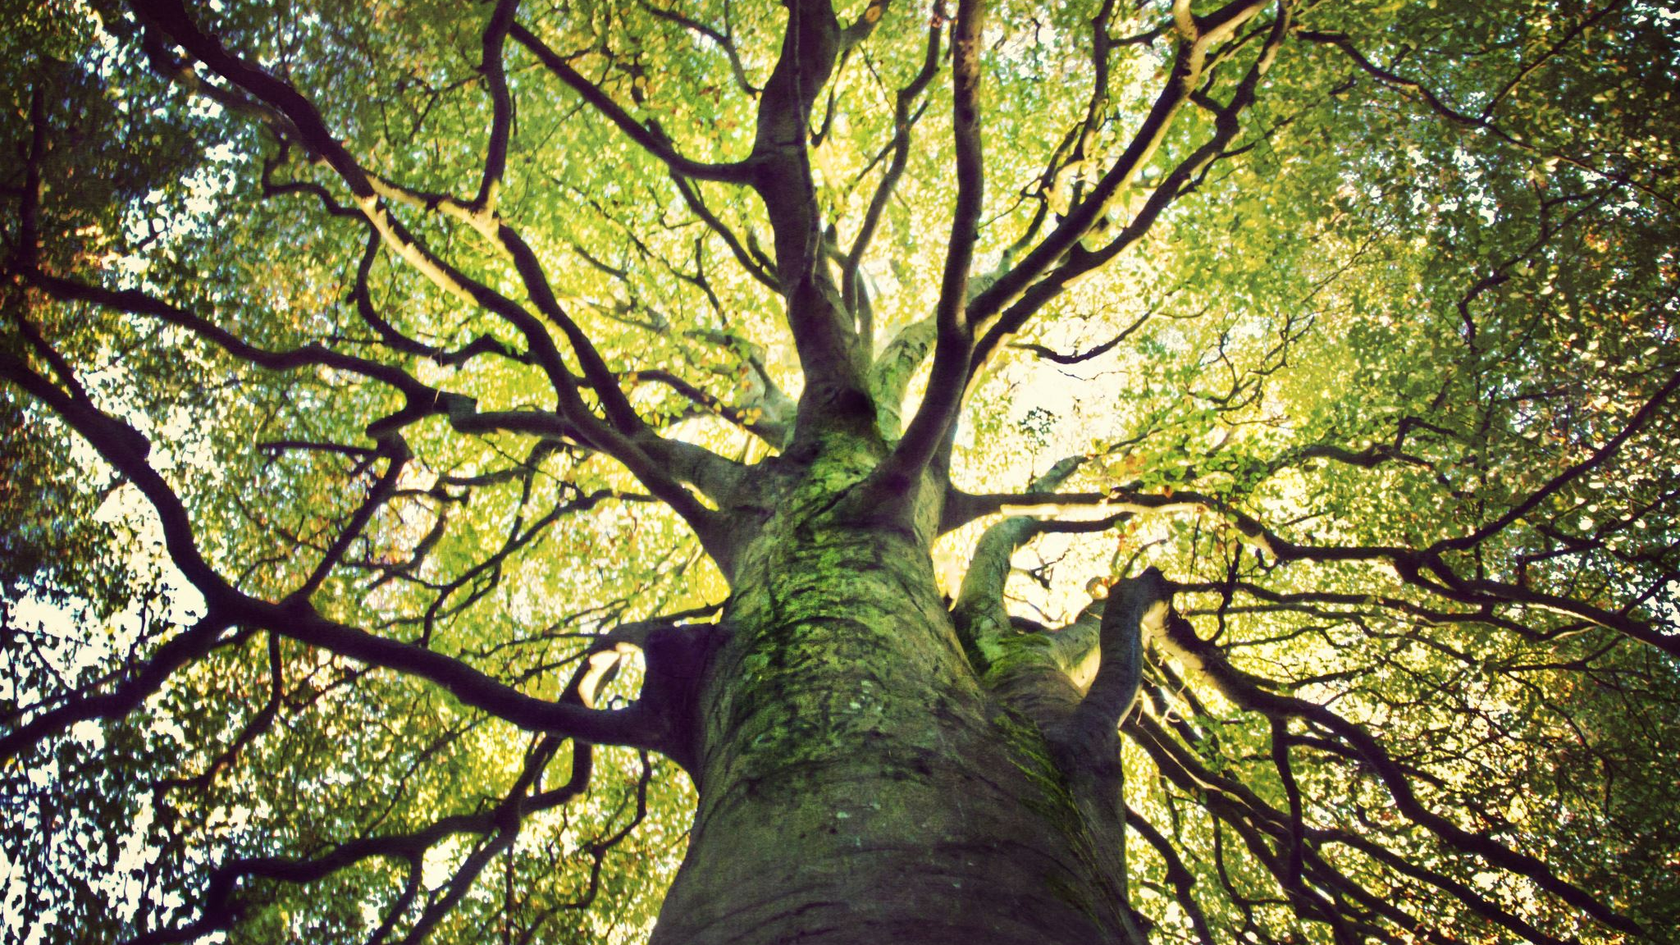
Spanning tree

Slide 18
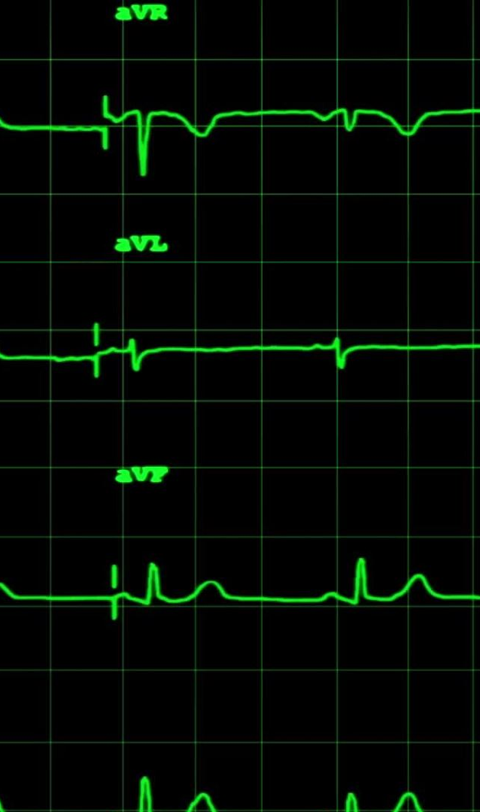
2. Spanning tree
A spanning tree is a sub-graph of an undirected connected graph, which includes all the vertices of the graph with a minimum possible number of edges.
If a vertex is missed, then it is not a spanning tree.
The edges may or may not have weights assigned to them.

Slide 19

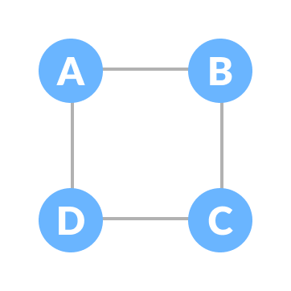
Example of a Spanning Tree
Let's understand the spanning tree with examples below:
Let the original graph be:

Slide 20
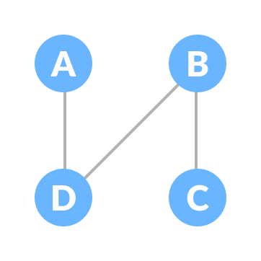
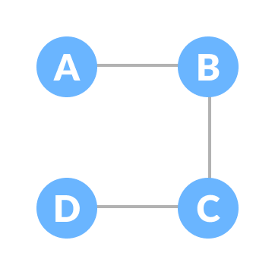
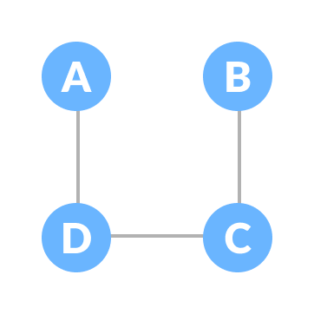
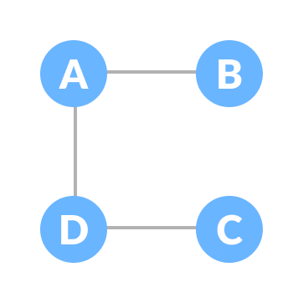
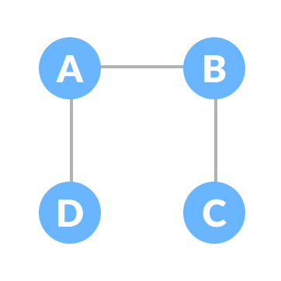
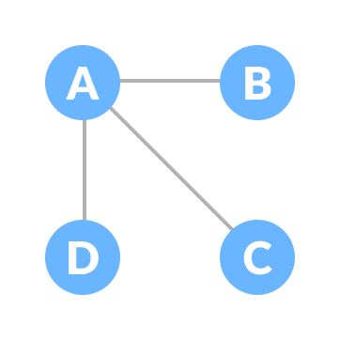
Some of the possible spanning trees that can be created from the above graph are:

Slide 21
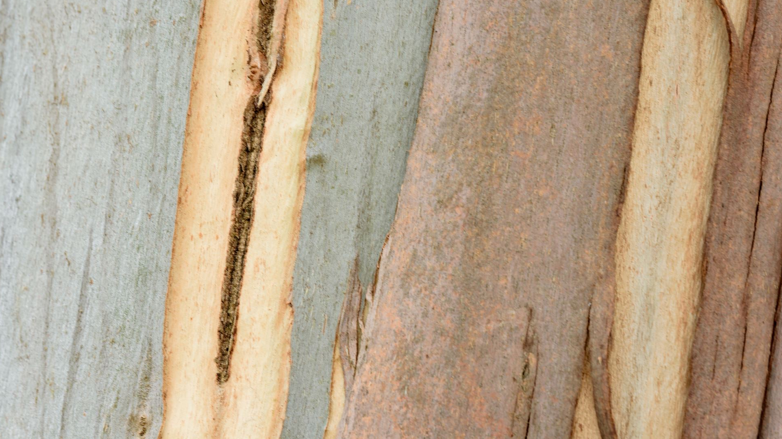
Minimum Spanning Tree

Slide 22
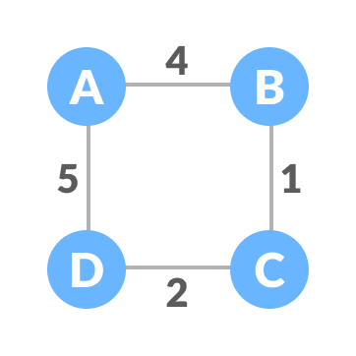
Minimum Spanning Tree (weighted)
A minimum spanning tree is a spanning tree in which the sum of the weight of the edges is as minimum as possible.
The initial graph is: "Weighted graph"

Slide 23
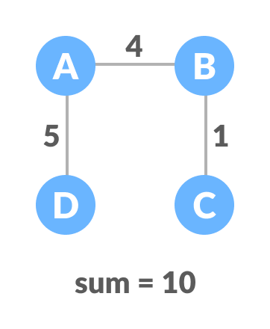
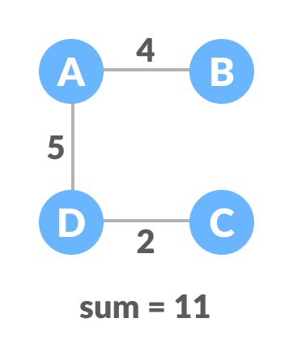
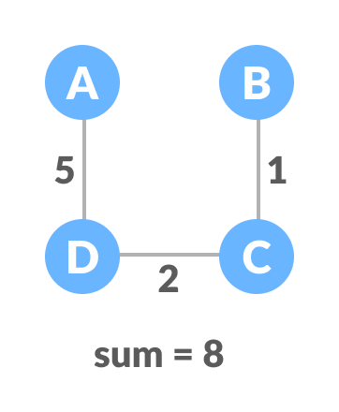
The possible spanning trees from the graph are:

Slide 24
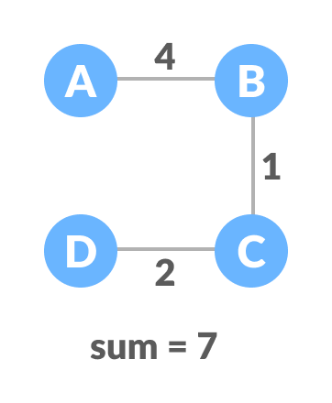
The minimum spanning tree from the previous spanning trees is:

Slide 25

Algorithms & Applications

Slide 26
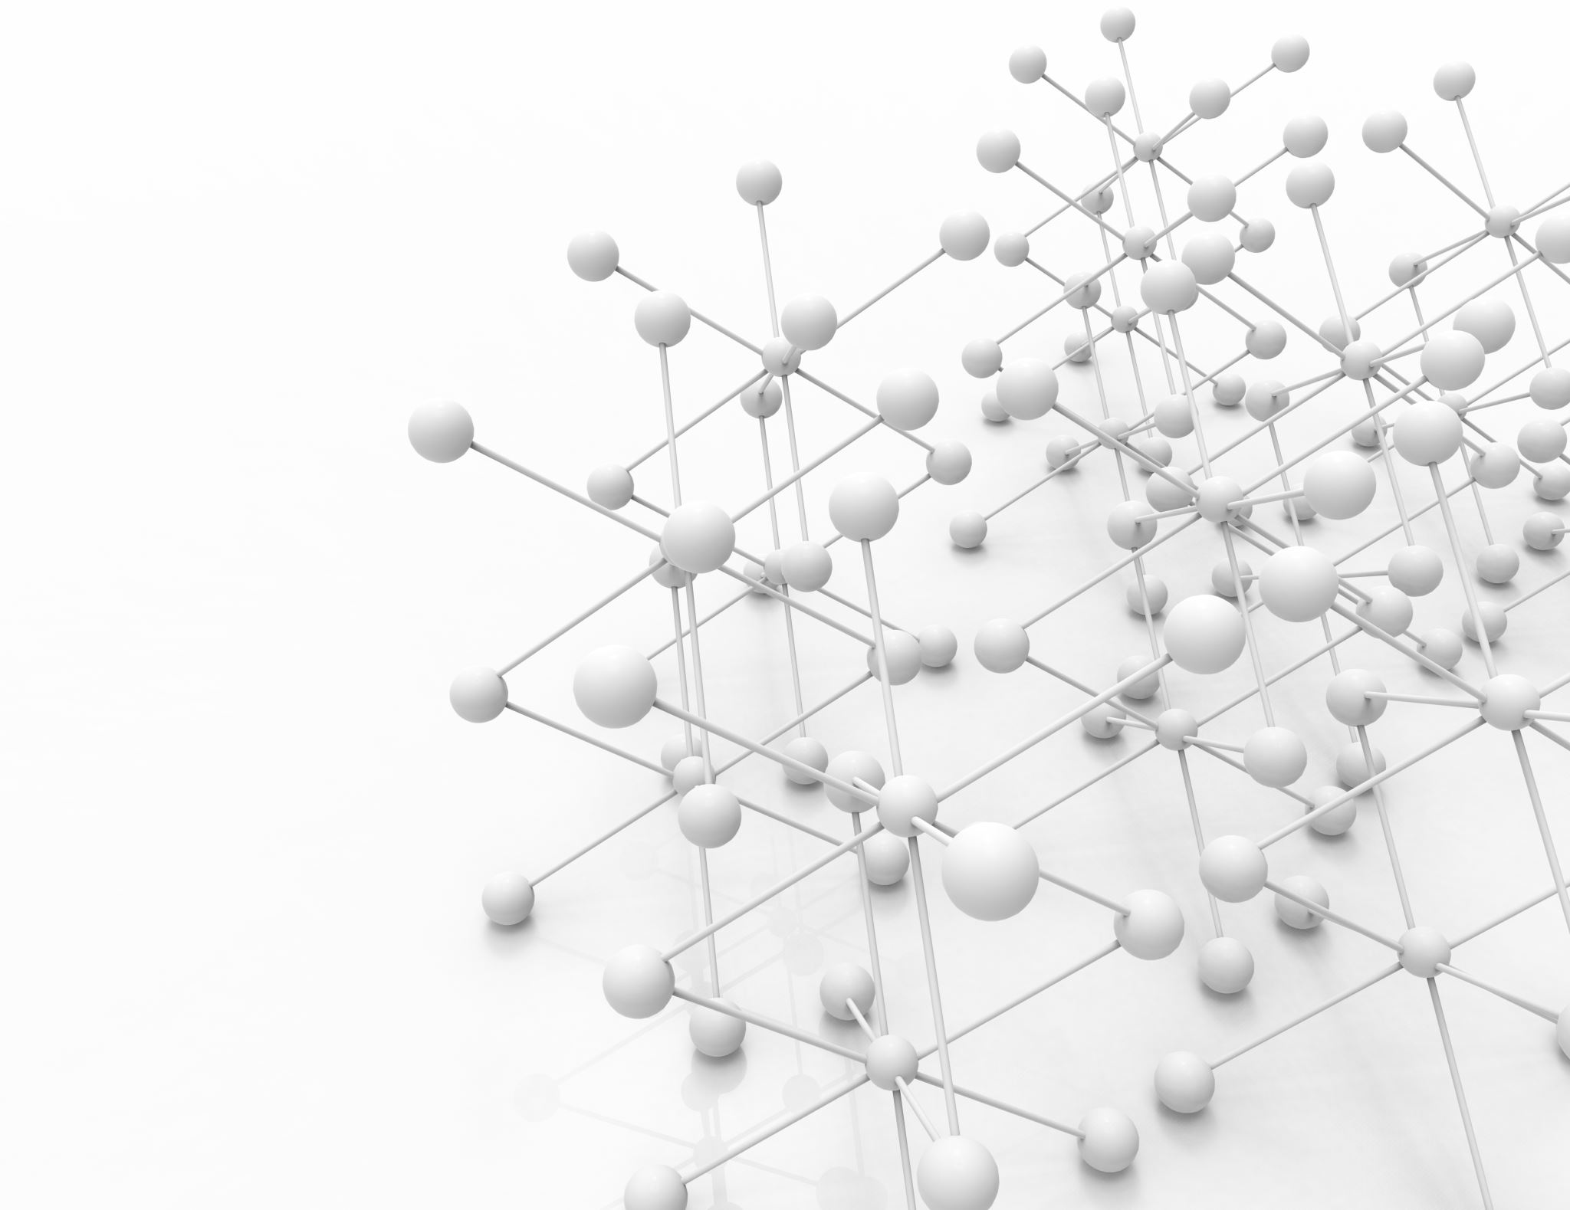
The minimum spanning tree from a graph is found using the following algorithms:
Prim's Algorithm
Kruskal's Algorithm

Slide 27

Spanning Tree Applications Computer Network Routing Protocol

Slide 28

Minimum Spanning tree Applications
To find paths in the map
To design networks like telecommunication networks, water supply networks, and electrical grids.

Slide 29

Strongly Connected Components

Slide 30
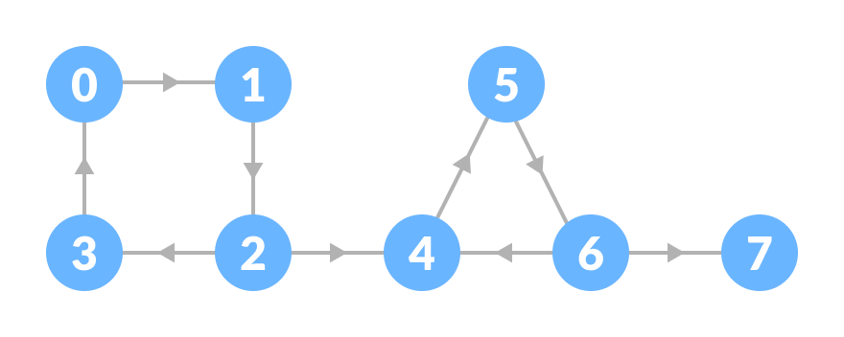

3. Strongly Connected Components
A strongly connected component is the portion of a directed graph in which there is a path from each vertex to another vertex. It is applicable only on a directed graph.
For example:
Let us take the graph.

Slide 31

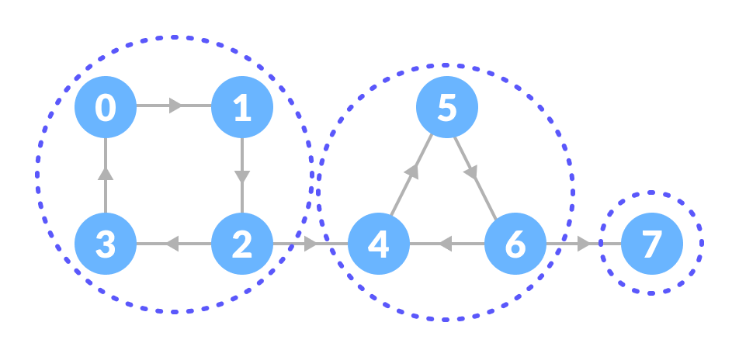
The strongly connected components of the above graph are:
Notes:
You can observe that in the first strongly connected component, every vertex can reach the other vertex through the directed path.

Slide 32

Strongly Connected Components Applications
Maps

Slide 33

4. Adjacency Matrix
Notes:
// Adjacency Matrix representation in Java public class Graph { private boolean adjMatrix[][]; private int numVertices; // Initialize the matrix public Graph(int numVertices) { this.numVertices = numVertices; adjMatrix = new boolean[numVertices][numVertices]; } // Add edges public void addEdge(int i, int j) { adjMatrix[i][j] = true; adjMatrix[j][i] = true; } // Remove edges public void removeEdge(int i, int j) { adjMatrix[i][j] = false; adjMatrix[j][i] = false; } // Print the matrix public String toString() { StringBuilder s = new StringBuilder(); for (int i = 0; i < numVertices; i++) { s.append(i + ": "); for (boolean j : adjMatrix[i]) { s.append((j ? 1 : 0) + " "); } s.append("\n"); } return s.toString(); } public static void main(String args[]) { Graph g = new Graph(4); g.addEdge(0, 1); g.addEdge(0, 2); g.addEdge(1, 2); g.addEdge(2, 0); g.addEdge(2, 3); System.out.print(g.toString()); } }

Slide 34
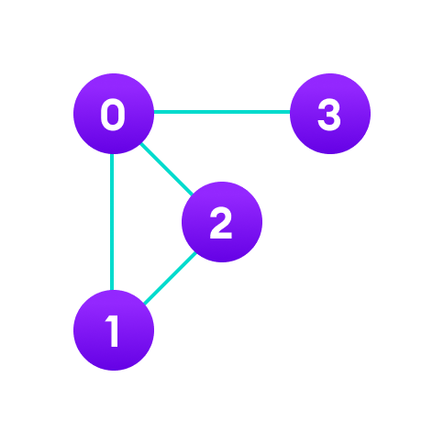
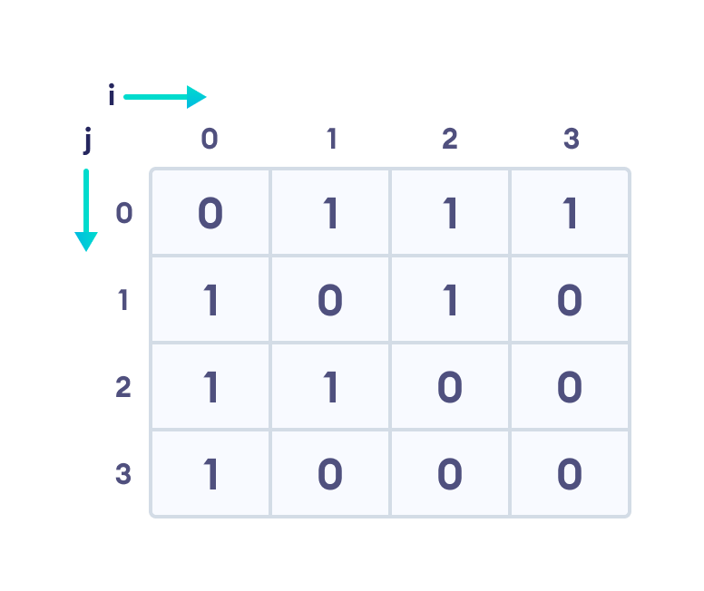
Matrix bases representation by booleans (0's and 1's).
A finite graph can be represented in the form of a square matrix.
Notes:
Each cell in the above table/matrix is represented as Aij, where i and j are vertices. The value of Aij is either 1 or 0 depending on whether there is an edge from vertex i to vertex j. If there is a path from i to j, then the value of Aij is 1 otherwise its 0. For instance, there is a path from vertex 1 to vertex 2, so A12 is 1 and there is no path from vertex 1 to 3, so A13 is 0.
In case of undirected graphs, the matrix is symmetric about the diagonal because of every edge (i,j), there is also an edge (j,i).

Slide 35
Pros of Adjacency Matrix
Dense Graphs - Adjacency Matrix
Matrix Advantages
Insights from Matrices

Slide 36
Cons of Adjacency Matrix
x Memory-Intensive (Adjacency Matrix)
Limited Scalability/flexibility for new edges.
Costly inEdges and outEdges (Matrix)

Slide 37

Adjacency Matrix Applications
Creating routing table in networks
Image processing and computer vision.

Slide 38

5. Adjacency List
Notes:
// Adjascency List representation in Java import java.util.*; class Graph { // Add edge static void addEdge(ArrayList<ArrayList<Integer>> am, int s, int d) { am.get(s).add(d); am.get(d).add(s); } public static void main(String[] args) { // Create the graph int V = 5; ArrayList<ArrayList<Integer>> am = new ArrayList<ArrayList<Integer>>(V); for (int i = 0; i < V; i++) am.add(new ArrayList<Integer>()); // Add edges addEdge(am, 0, 1); addEdge(am, 0, 2); addEdge(am, 0, 3); addEdge(am, 1, 2); printGraph(am); } // Print the graph static void printGraph(ArrayList<ArrayList<Integer>> am) { for (int i = 0; i < am.size(); i++) { System.out.println("\nVertex " + i + ":"); for (int j = 0; j < am.get(i).size(); j++) { System.out.print(" -> " + am.get(i).get(j)); } System.out.println(); } } }

Slide 39

Adjacency List
An adjacency list represents a graph as an array of linked lists. The index of the array represents a vertex and each element in its linked list represents the other vertices that form an edge with the vertex.
Array List: Contiguous
Linked List: Non-Contiguous

Slide 40
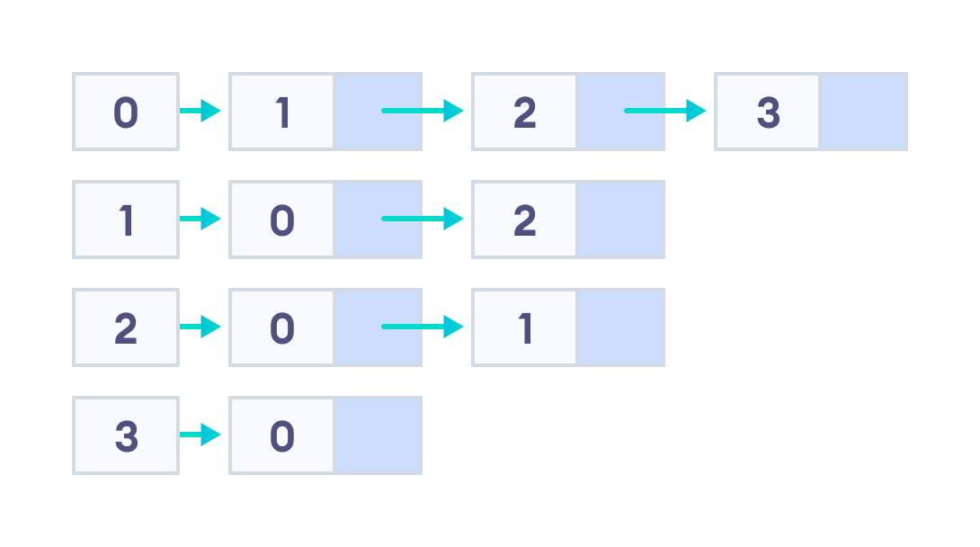
Vertices : 0, 1, 2, 3:
Each of them forms a linked list with all of its adjacent vertices.
Src
Destinations

Slide 41

Efficient Storage
Easy to insert and delete.
Pros of Adjacency List

Slide 42
Cons of Adjacency List
Adjacent list not faster than adjacency matrix ; all the connected nodes must be first explored to find them.
i.e., traversing is costly as compare to Adjacency matrix.

Slide 43

6. Depth First Search (DFS)
Notes:
// DFS algorithm in Java import java.util.*; class Graph { private LinkedList<Integer> adjLists[]; private boolean visited[]; // Graph creation Graph(int vertices) { adjLists = new LinkedList[vertices]; visited = new boolean[vertices]; for (int i = 0; i < vertices; i++) adjLists[i] = new LinkedList<Integer>(); } // Add edges void addEdge(int src, int dest) { adjLists[src].add(dest); } // DFS algorithm void DFS(int vertex) { visited[vertex] = true; System.out.print(vertex + " "); Iterator<Integer> ite = adjLists[vertex].listIterator(); while (ite.hasNext()) { int adj = ite.next(); if (!visited[adj]) DFS(adj); } } public static void main(String args[]) { Graph g = new Graph(4); g.addEdge(0, 1); g.addEdge(0, 2); g.addEdge(1, 2); g.addEdge(2, 3); System.out.println("Following is Depth First Traversal"); g.DFS(2); } }

Slide 44
Depth First Search (DFS)
Depth first Search or Depth first traversal is a algorithm for searching all the vertices of a graph or tree data structure. Traversal means visiting all the nodes of a graph.

Slide 45

Depth First Search Example
Let's see how the Depth First Search algorithm works with an example. We use an undirected graph with 5 vertices.

Slide 46
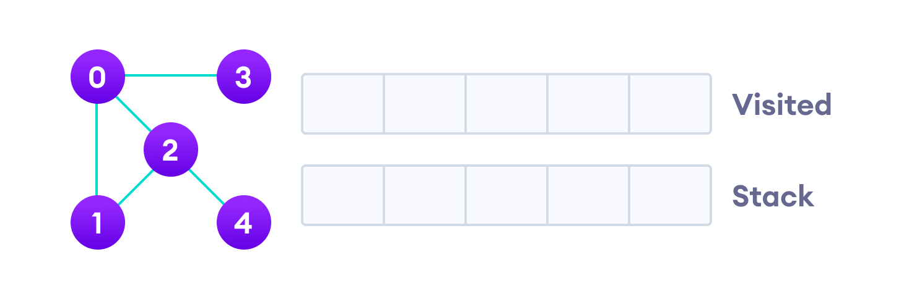
Undirected graph with 5 vertices

Slide 47
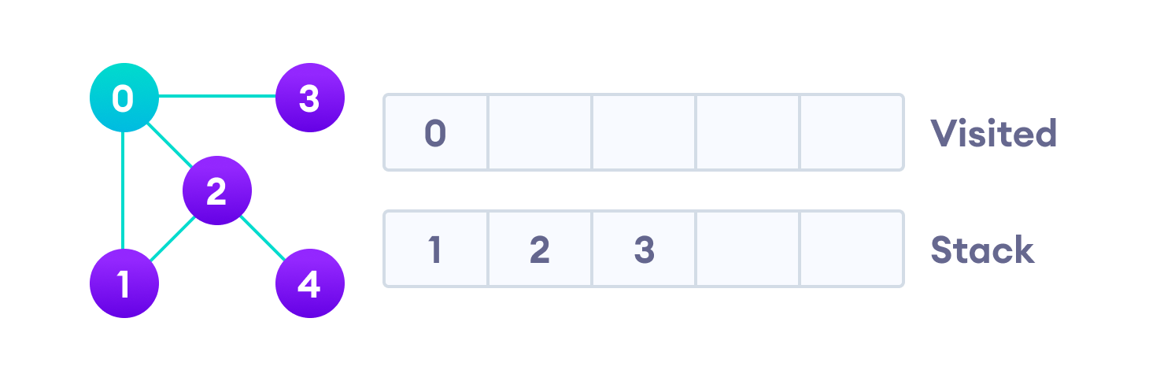
We start from vertex 0, the DFS algorithm starts by putting it in the Visited list and putting all its adjacent vertices in the stack.
Visit the element and put it in the visited list

Slide 48
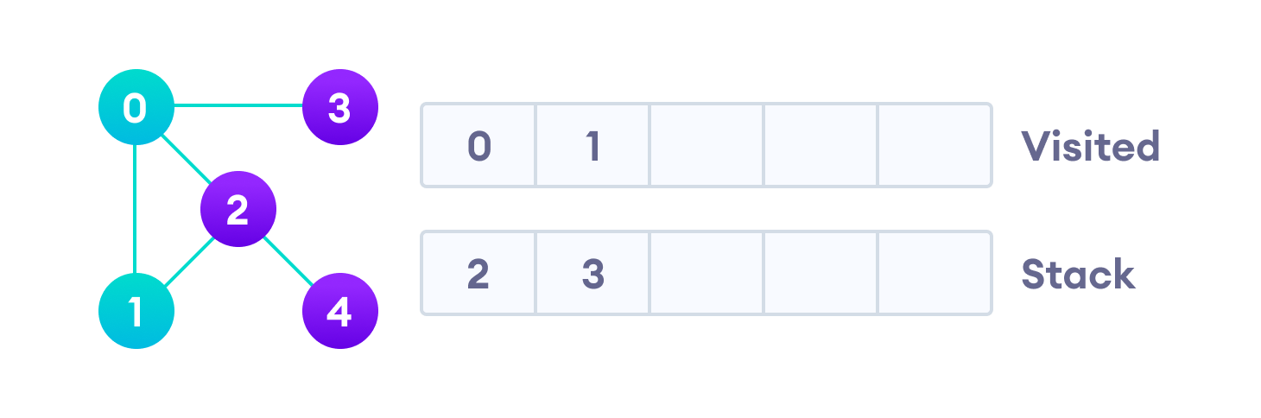
Next, we visit the element at the top of stack i.e. 1 and go to its adjacent nodes. Since 0 has already been visited, we visit 2 instead.
Visit the element at the top of stack

Slide 49
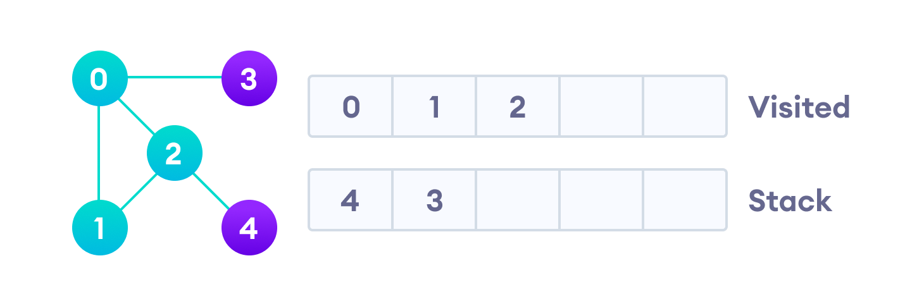
Vertex 2 has an unvisited adjacent vertex in 4, so we add that to the top of the stack and visit it.

Slide 50
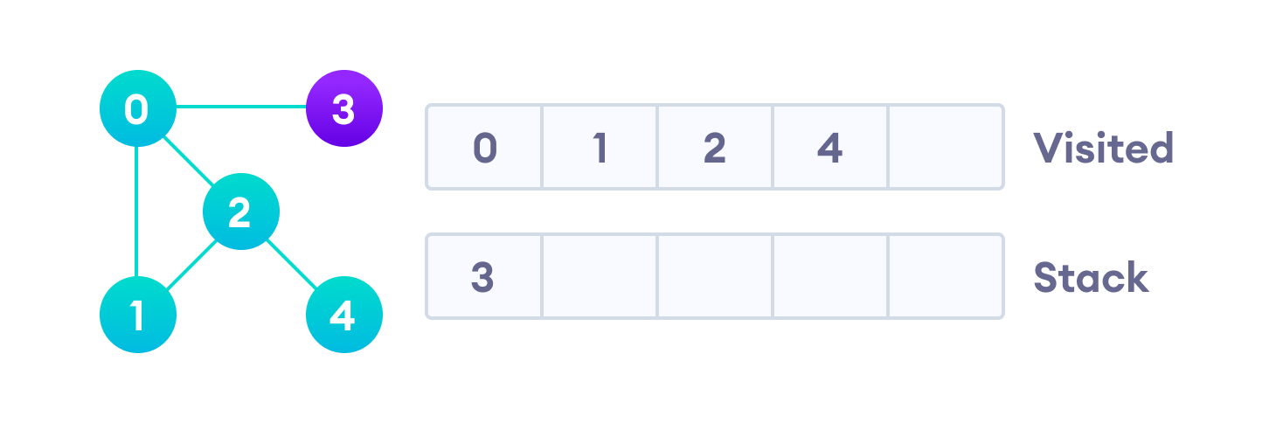
Vertex 2 has an unvisited adjacent vertex in 4, so we add that to the top of the stack and visit it.

Slide 51
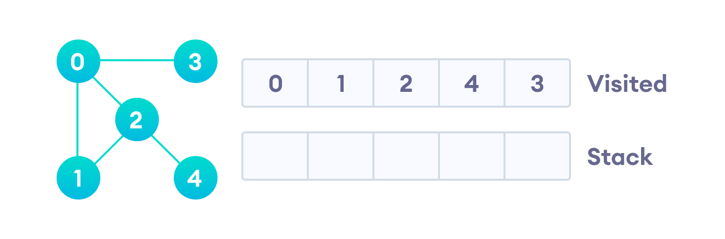
After we visit the last element 3, it doesn't have any unvisited adjacent nodes, so we have completed the Depth First Traversal of the graph.

Slide 52

Depth First Search Algorithm
A standard DFS implementation puts each vertex of the graph into one of two categories:
1) Visited
2) Not Visited
The purpose of the algorithm is to mark each vertex as visited while avoiding cycles.
The DFS algorithm works as follows:
1) Start by putting any one of the graph's vertices on top of a stack.
2) Take the top item of the stack and add it to the visited list.
3) Create a list of that vertex's adjacent nodes.
4) Keep repeating steps 2 and 3 until the stack is empty.
Add the ones which aren't in the visited list to the top of the stack.

Slide 53
DFS Pseudocode (recursive implementation)
The pseudocode for DFS is shown below. In the init() function, notice that we run the DFS function on every node. This is because the graph might have two different disconnected parts so to make sure that we cover every vertex, we can also run the DFS algorithm on every node.
DFS(G, u) u.visited = true for each v ∈ G.Adj[u] if v.visited == false DFS(G,v) init() { For each u ∈ G u.visited = false For each u ∈ G DFS(G, u) }

Slide 54

Complexity of Depth First Search
The time complexity of the DFS algorithm is represented in the form of O(V + E), where V is the number of nodes and E is the number of edges.
The space complexity of the algorithm is O(V).

Slide 55

Application of DFS Algorithm

Slide 56

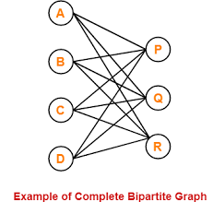
For finding the path
To test if the graph is bipartite
For finding the strongly connected components of a graph
For detecting cycles in a graph
Bipartite: All edges connect a vertex in one set to a vertex in another set

Slide 57

DFS
One of the Best Application: When you Send complaint to main branch/the root.
DFS is same as Pre, Post, and In order traversal in tree.

Slide 58

7. Breadth first search

Slide 59

Breadth first search
Breadth First Traversal or Breadth First Search is a recursive algorithm for searching all the vertices of a graph or tree data structure.

Slide 60
Breadth First Search Algorithm
A standard BFS implementation puts each vertex of the graph into one of two categories:
1) Visited
2) Not Visited
The purpose of the algorithm is to mark each vertex as visited while avoiding cycles.
The algorithm works as follows:
Step1: Start by putting any one of the graph's vertices at the back of a queue.
Step2: Take the front item of the queue and add it to the visited list.
Step3: Create a list of that vertex's adjacent nodes. Add the ones which aren't in the visited list to the back of the queue.
Step4: Keep repeating steps 2 and 3 until the queue is empty.
Notes:
The graph might have two different disconnected parts so to make sure that we cover every vertex, we can also run the BFS algorithm on every node

Slide 61
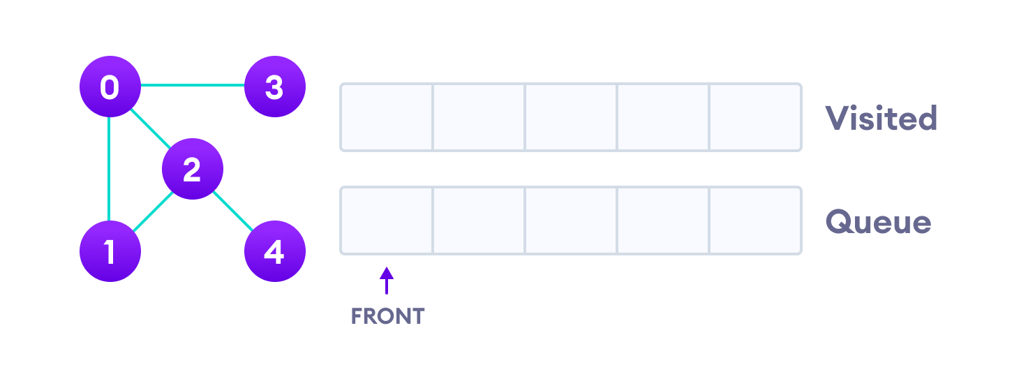
BFS example

Slide 62
Let's see how the Breadth First Search algorithm works with an example. We use an undirected graph with 5 vertices.
Undirected graph with 5 vertices

Slide 63
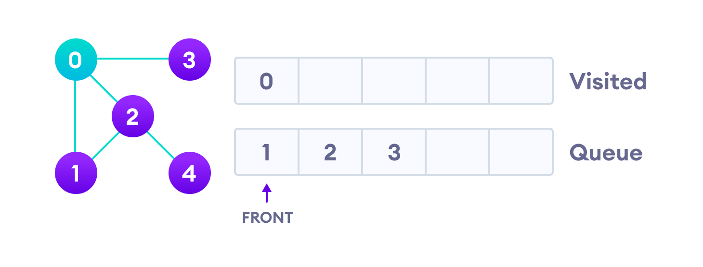
We start from vertex 0, the BFS algorithm starts by putting it in the Visited list and putting all its adjacent vertices in the queue.
Visit start vertex and add its adjacent vertices to queue

Slide 64
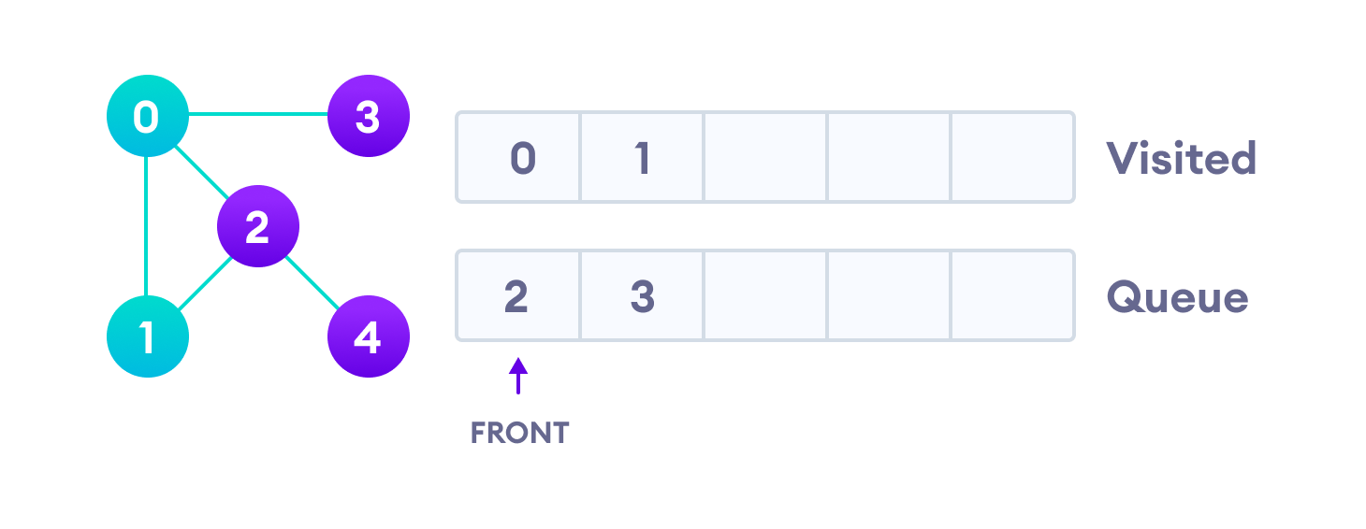
Next, we visit the element at the front of queue i.e. 1 and go to its adjacent nodes. Since 0 has already been visited, we visit 2 instead.
Visit the first neighbour of start node 0, which is 1

Slide 65
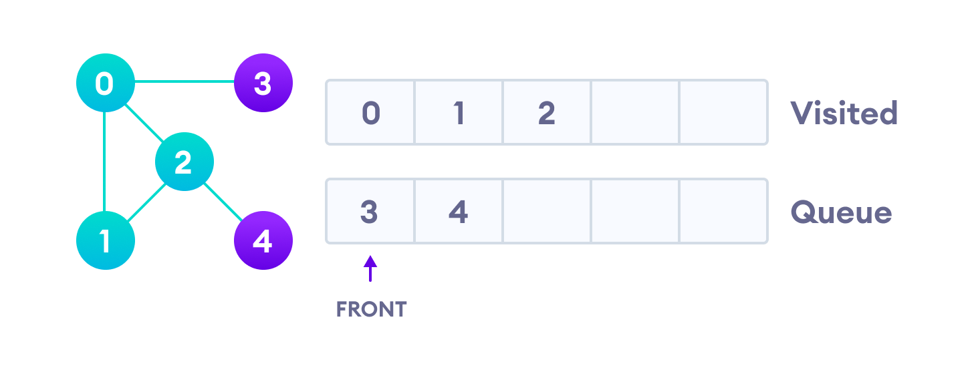
Vertex 2 has an unvisited adjacent vertex in 4, so we add that to the back of the queue and visit 3, which is at the front of the queue.
Visit 2 which was added to queue earlier to add its neighbours

Slide 66
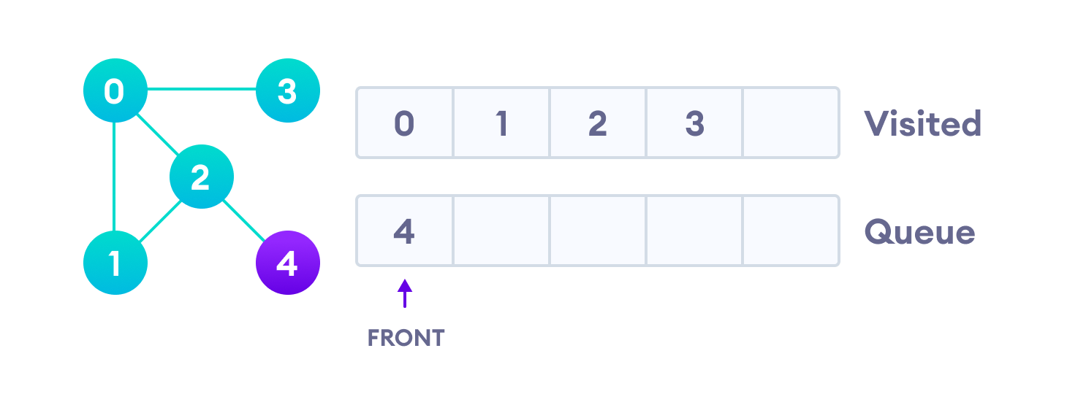
4 remains in the queue
Only 4 remains in the queue since the only adjacent node of 3 i.e. 0 is already visited. We visit it.

Slide 67
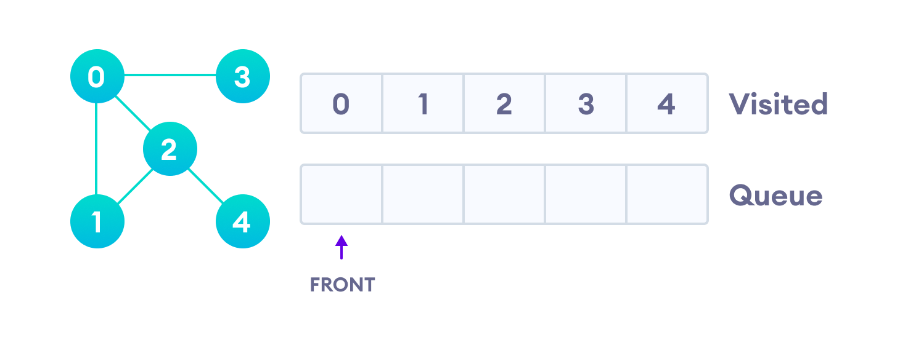
Visit last remaining item in the queue to check if it has unvisited neighbors
Since the queue is empty, we have completed the Breadth First Traversal of the graph.

Slide 68

BFS pseudocode
Notes:
// BFS algorithm in Java import java.util.*; public class Graph { private int V; private LinkedList<Integer> adj[]; // Create a graph Graph(int v) { V = v; adj = new LinkedList[v]; for (int i = 0; i < v; ++i) adj[i] = new LinkedList(); } // Add edges to the graph void addEdge(int v, int w) { adj[v].add(w); } // BFS algorithm void BFS(int s) { boolean visited[] = new boolean[V]; LinkedList<Integer> queue = new LinkedList(); visited[s] = true; queue.add(s); while (queue.size() != 0) { s = queue.poll(); System.out.print(s + " "); Iterator<Integer> i = adj[s].listIterator(); while (i.hasNext()) { int n = i.next(); if (!visited[n]) { visited[n] = true; queue.add(n); } } } } public static void main(String args[]) { Graph g = new Graph(4); g.addEdge(0, 1); g.addEdge(0, 2); g.addEdge(1, 2); g.addEdge(2, 0); g.addEdge(2, 3); g.addEdge(3, 3); System.out.println("Following is Breadth First Traversal " + "(starting from vertex 2)"); g.BFS(2); } }

Slide 69
BFS Pseudocode
create a queue Q mark v as visited and put v into Q while Q is non-empty remove the head u of Q mark and enqueue all (unvisited) neighbours of u
BFS is same as Level Order in Tree

Slide 70

BFS Algorithm Complexity
The time complexity of the BFS algorithm is represented in the form of O(V + E), where V is the number of nodes and E is the number of edges.
The space complexity of the algorithm is O(V).

Slide 71
BFS Algorithm Applications (PoPs in networking)
To build index by search index
For GPS navigation
Path finding algorithms
In Ford-Fulkerson algorithm to find maximum flow in a network
Cycle detection in an undirected graph
In minimum spanning tree.

Slide 72
Are we allowed to make the graph coded???

Slide 73
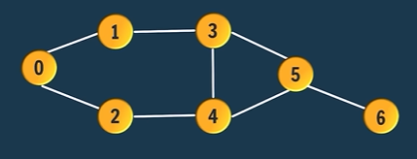

Slide 74
Graph Code: Create Adjacency List for Graph memory representation
Step1: Create a node class with Source and Destination Attributes.
Step2: Create an Array of Array List, arraySize is equals to number of vertices, must initialize all the lists to concrete list objects to avoid NullPointerException.
Array of Array Lists → ArrayList<Edge> graph[] = new ArrayList[vertices];
Write down the code of step 2 inside the main method
Step3: Create edges and connect them with vertices:
graph[vertex].add(new Edge(source, destination));
Notes:
import java.util.ArrayList;
public class mainGraph {
static class Edge{
int src;
int dest;
Edge(int src, int dest)
{
this.src = src;
this.dest = dest;
}
public static void main(String[] args) {
/*
ConnectedGraph
1 ----3-----
/ | \
0 | 5
\ | / \
2----4------- 6
*/
ArrayList<Edge> graph[] = new ArrayList[7];
for(int i=0; i<graph.length; i++)
{
graph[i] = new ArrayList();
}
graph[0].add(new Edge(0,1));
graph[0].add(new Edge(0,2));
graph[1].add(new Edge(1,3));
graph[1].add(new Edge(1,0));
graph[2].add(new Edge(2,0));
graph[2].add(new Edge(2,4));
graph[3].add(new Edge(3,1));
graph[3].add(new Edge(3,4));
graph[3].add(new Edge(3,5));
graph[3].add(new Edge(4,2));
graph[3].add(new Edge(4,5));
graph[3].add(new Edge(5,3));
graph[3].add(new Edge(5,4));
graph[3].add(new Edge(6,5));
//iterating
for (ArrayList<Edge> vertex : graph) {
for (int j = 0; j < vertex.size(); j++) {
System.out.print("src: " + vertex.get(j).src + " ");
System.out.print("dest: " + vertex.get(j).dest + " ");
System.out.println("");
}
}
}
}
}

Slide 75
BFS(graphEdges[], vertices)
Step1: SET visited[vertices] //Boolean array
SET Queue[vertices] //i.e., int in this case
SET Q.add(initialSource)
Step4: Repeat While( Queue is not empty)
SET current = Q.remove
Step5: If(visited[current] # TRUE)
print(current)
SET visited[current] = TRUE
[End of If Structure]
SET LCV:= 0
Step6: Repeat while( LCV < graph[current].size)
print graphEdges[current]
Q.add(destination)
SET LCV := LCV +1 [End Step6Loop]
[End Step4 Loop]
Step7: Exit

Slide 76
DFS
public static void dfs(ArrayList graph[], int curr, boolean visited[]) {
if(visited[curr])
{ return; }
System.out.print(curr+" ");
visited[curr] = true;
for(int i=0; i<graph[curr].size(); i++) {
Edge e = graph[curr].get(i);
dfs(graph, e.dest, visited);
}
}

Slide 77

Thank You
RADHE RADHE

